Slide 1
Battle of the Neighborhoods
Coursera Data Science Capstone Final

Slide 2
Neighborhood Recommendation Engine
For families and individuals considering relocation to an unfamiliar large city, it can be overwhelming to know where to start looking for a neighborhood that will fit their preferences and needs at that time in their lives.
A recommendation engine assessing the various neighborhoods within a metropolitan area would assist potential movers with little-to-no familiarity with their future city in quickly locating neighborhoods that would be the most likely fit for them. For this application, a set of personas with assumptions regarding their preferences will be formed, and the recommendations will be formed for the personas.

Slide 3
Data Needs & Sources
The following are our high-level data needs for this analysis:
A list of neighborhoods with geographical coordinates (latitude and longitude)
A list of Foursquare venue categories plus the top level category for each
A list of venues for each neighborhood with category assigned.
The following data sources will be used to conduct this analysis:
List of Toronto Postal Codes - includes Postcode, Borough, Neighborhood
Toronto Postal Codes with Latitude and Longitude
Foursquare Venues / Explore API - to retrieve venues located within a certain distance of the center of the neighborhood
Foursquare Venue Category Hierarchy - the foursquare category list / hierarchy will be retrieved and processed to identify the top-level category for each venue

Slide 4
Data Wrangling
The following steps will be conducted to get the data ready for analysis
Form a list of neighborhood names with latitude and longitude by combining the list of Neighborhoods with Postal Codes with the list of Postal Codes with latitude and longitude
Copy the category hierarchy into excel and manipulate to identify the top-level category for each lower-level category. Save as CSV and upload to Watson
Retrieve all of the venues within a certain radius of each neighborhood's latitude and longitude coordinates
Iterate through the venues to assign the top-level category to each venue

Slide 5
Data Analysis
Apply one-hot encoding to the Top-Level Category column and then group by Neighborhood to prepare for k-means clustering
The resulting data sets were then reviewed for emerging themes through which personas were identified and applied to the data set.

Slide 6
Results
Through experimentation, a k-means cluster number of 3 was found to render a meaningful grouping of neighborhoods. Higher numbers tended to split the data set into groupings that had less obvious themes. The clusters were identified as the following Personas, based on the top categories in each cluster:
Urban Foodies
Outdoor Enthusiasts
Suburban Shoppers
While the inclusion of the number of venues did not seem to materially impact the composition of the clusters, it did help with identifying the Personas for each cluster.

Slide 7
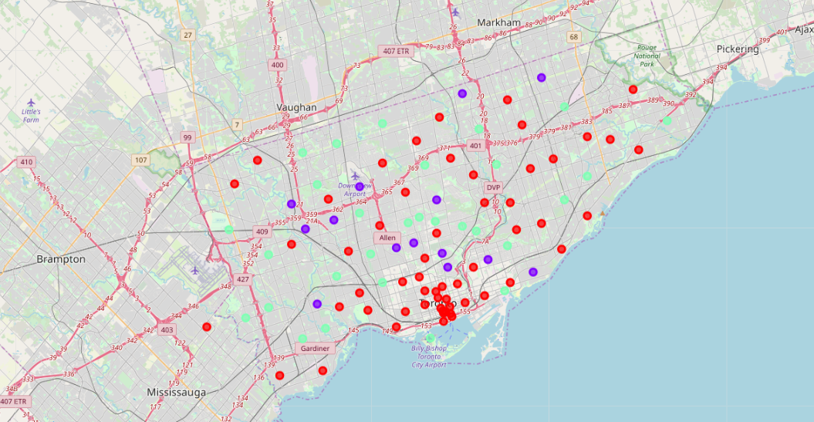
Map of Results

